Slide 1

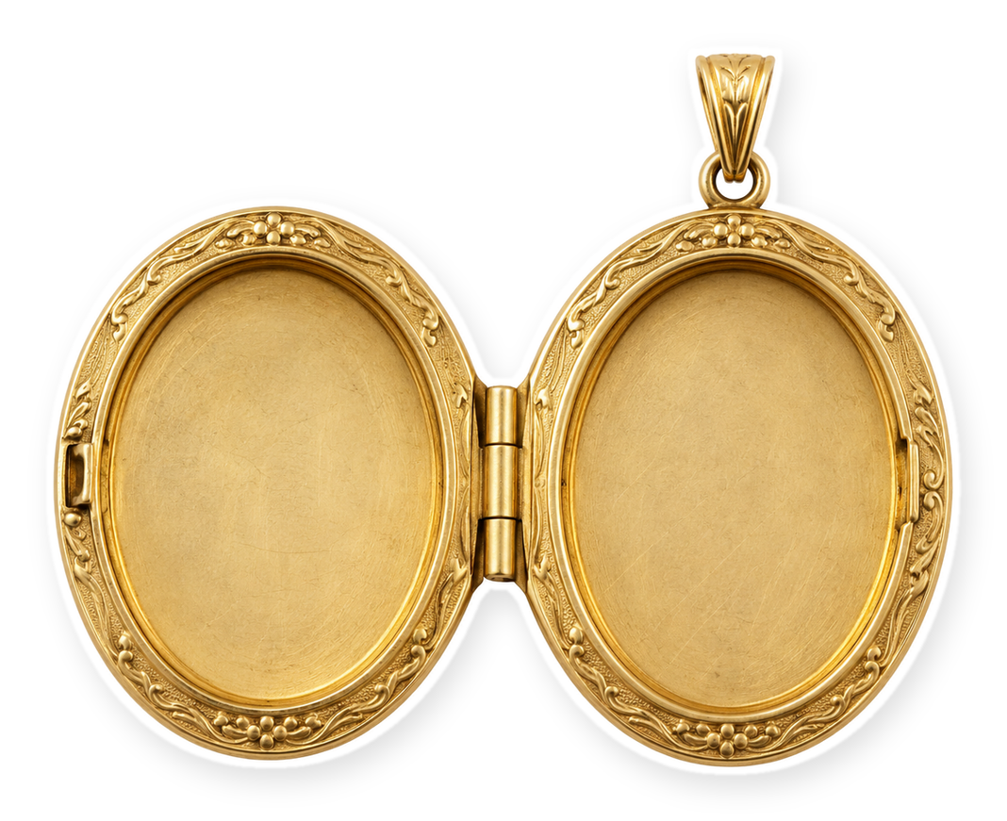


pair it with
[my steam mop]
Everything blue is a guide. Delete it before you download.
Notes:
Slide 1. Hook. Your product goes in the left of the locket, the first pairing in the right. Edit [my steam mop].

Slide 2
[it's even better
with a partner]
?
[see the pairs]
Notes:
Slide 2. Second hook: Instagram often shows a carousel starting on slide 2, so this one works as a cover on its own. Your product in the left of the locket. Edit both [bracket] lines.

Slide 3

+ [the stick vacuum]
Notes:
Slide 3. Pairing 1: a full-page photo. Name it.

Slide 4
+ [the odor spray]
Notes:
Slide 4. Pairing 2 in the right of the locket. Name it.

Slide 5


+ [the litter]
Notes:
Slide 5. Pairing 3: swap in its photo. Name it.

Slide 6


a perfect pair
+
[ask about the bundle]
Notes:
Slide 6. Your product and its best pairing side by side. Edit the line.

Slide 7


Comment
"[KEYWORD]"
[bundle name]
Notes:
Slide 7. Four photos: your product and its pairings. Type the bundle name and your keyword. Caption to start from (CTA in the first two sentences, 3 hashtags): Comment [KEYWORD] and I will send you [the link]. [One line of real context: who it helps or how you use it.] #[tag] #[tag] #[tag]

